Slide 1

Monitor Online Store Performance Dashboard
Group 02
Final Presentation
Link to Dataset

Slide 2
Table of Contents
Project Summary
About Team Members
Project Progress
Project Cost
Project Result
Conclusion

Slide 3
Project Summary
Smart Solutions, an established online electronics store, aims to enhance its marketing strategy and performance monitoring by properly storing data in a database and using a dashboard.
They seek third-party assistance to efficiently transform raw data, standardize reporting formats, and develop an interactive dashboard due to the challenges faced in these areas.

Slide 4

Team Members:
Quyen Nguyen
Project Manager
Data Analyst
Satish Kumar
Team Member
Data Analyst
Kush Yogeshbhai Parmar
Team Member
Data Analyst

Slide 5
Project Progress:
Data Sourcing and Loading.
Data Transforming and Cleaning.
Exploratory Data Analysis(EDA)
Predictive Analysis
Final Dashboard Development

Slide 6
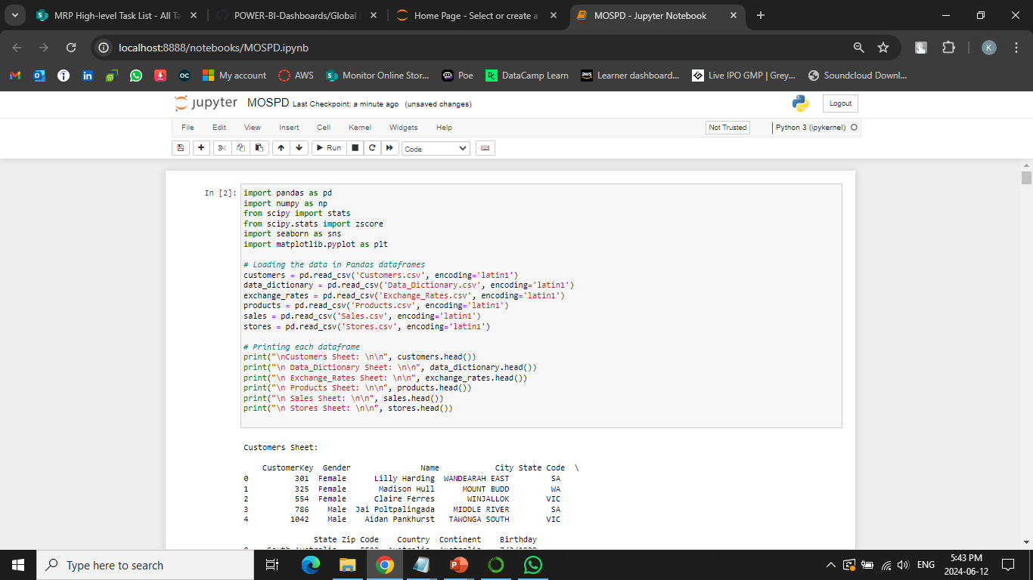
Data Sourcing and Loading:

Slide 7
Data Transforming and Cleaning:
We familiarized ourselves with the client's dataset and performed the necessary cleaning using Python.
We reviewed and comprehended our dataset.
We carried out Exploratory Data Analysis (EDA) on the entire dataset to gain a thorough understanding.

Slide 8
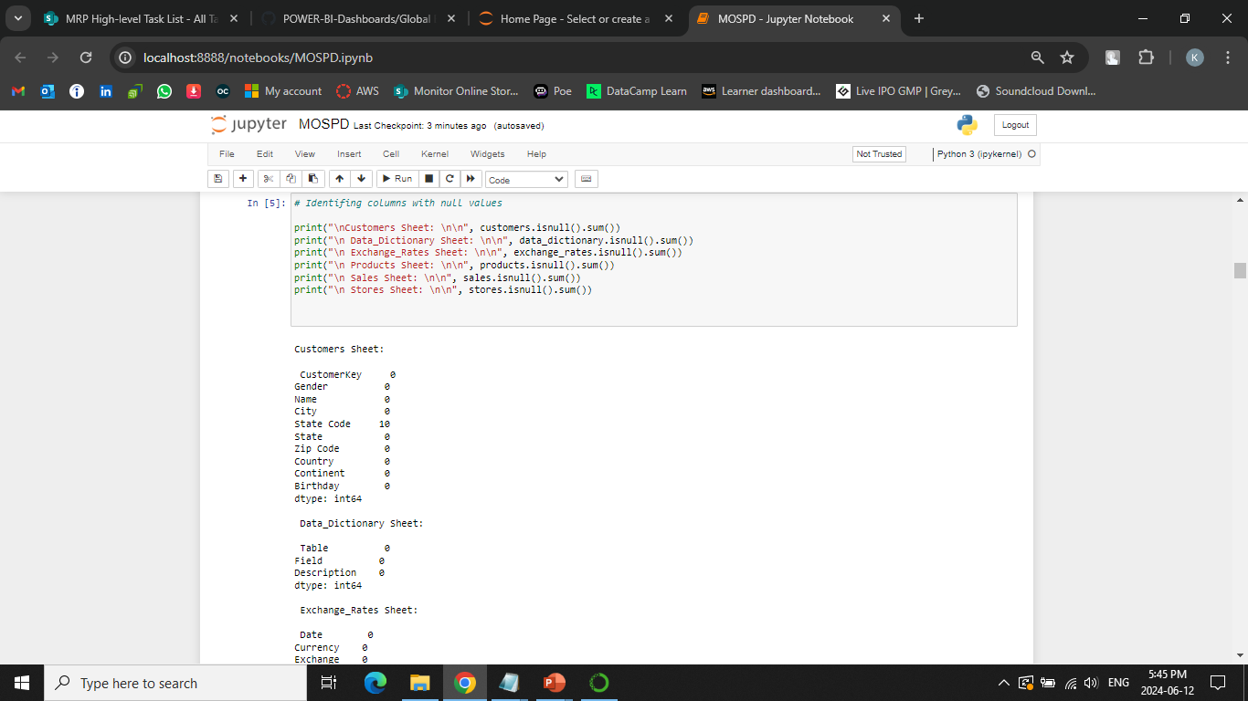

Slide 9
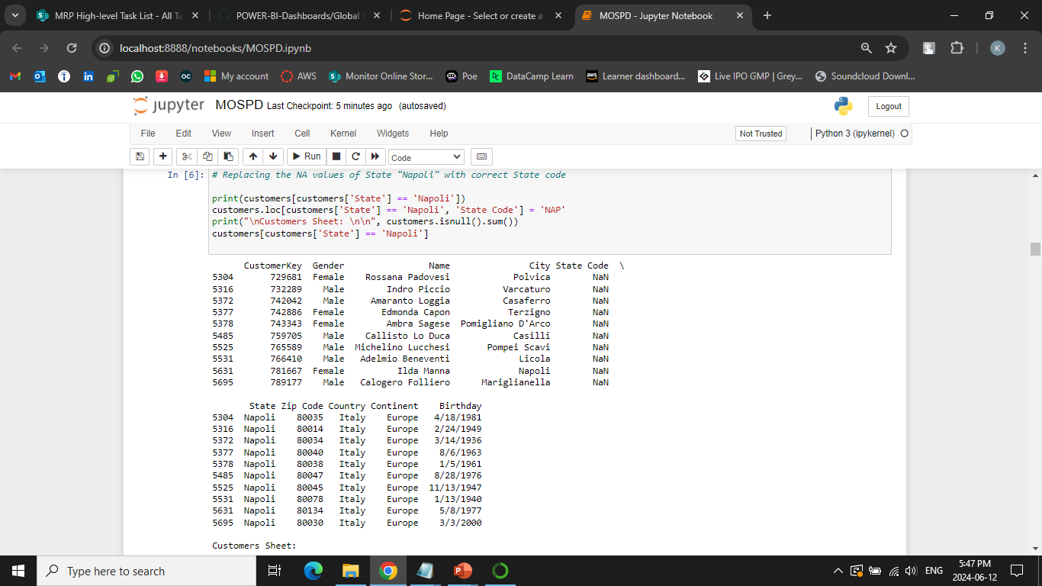

Slide 10
Exploratory Data Analysis(EDA):
Conducted Exploratory Data Analysis (EDA) on the cleaned dataset.
Gained an overview and understanding of the data.
Developed insights to guide further analysis and modeling.

Slide 11
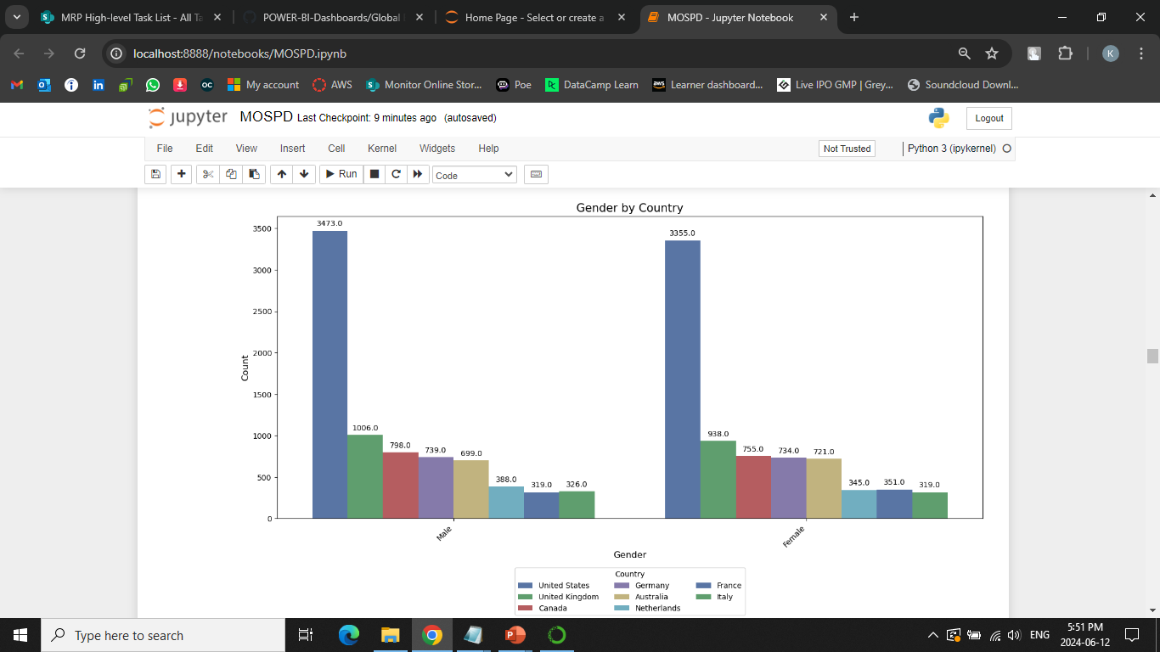
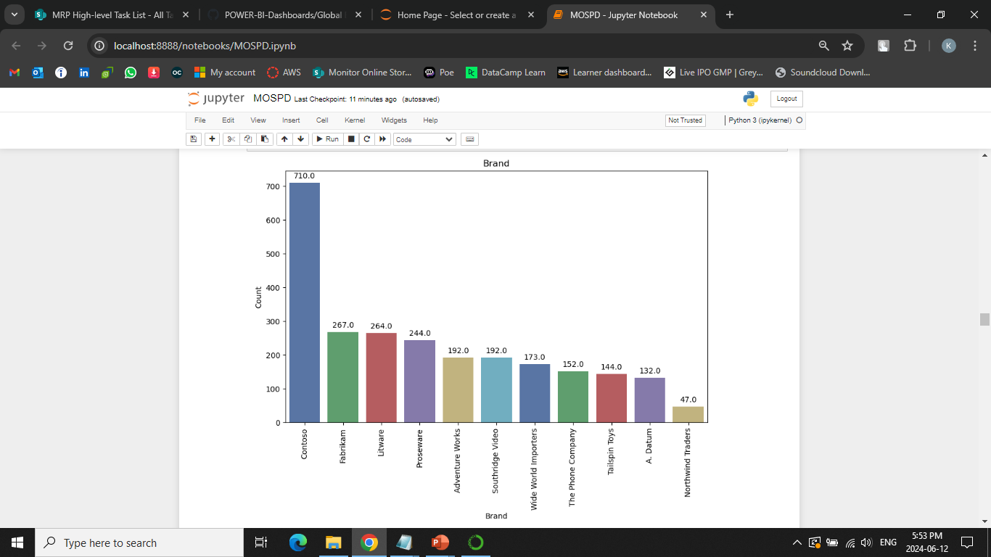
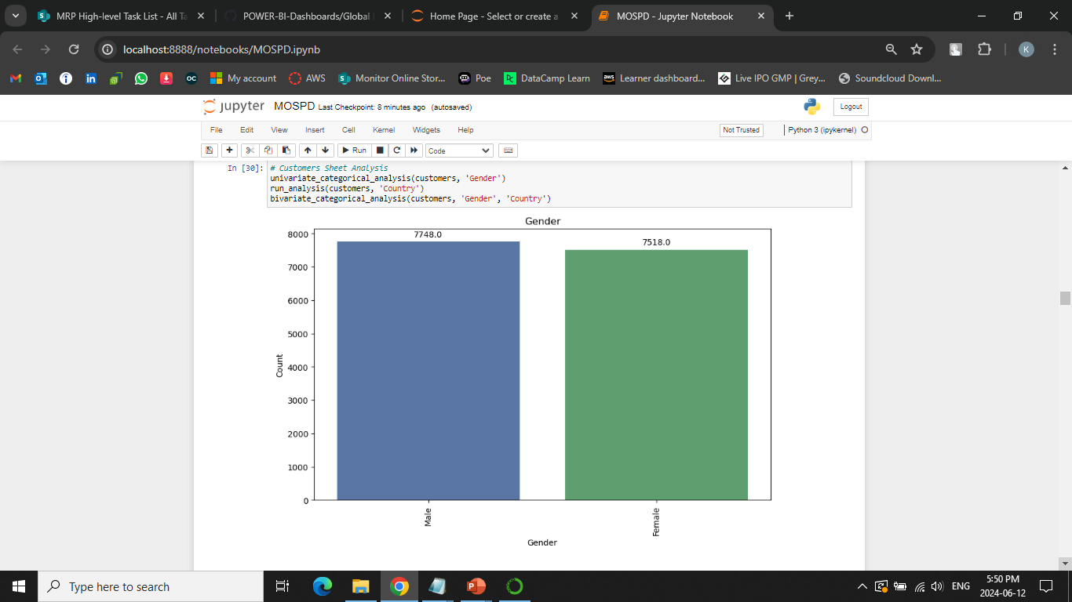

Slide 12
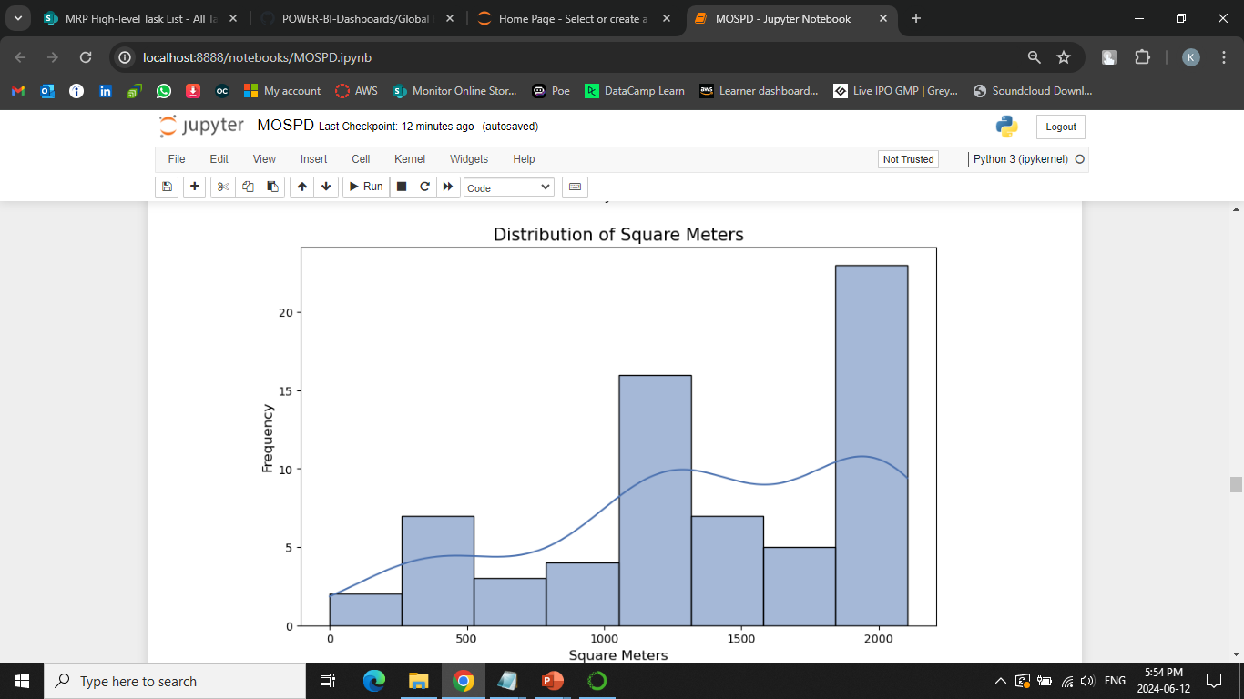
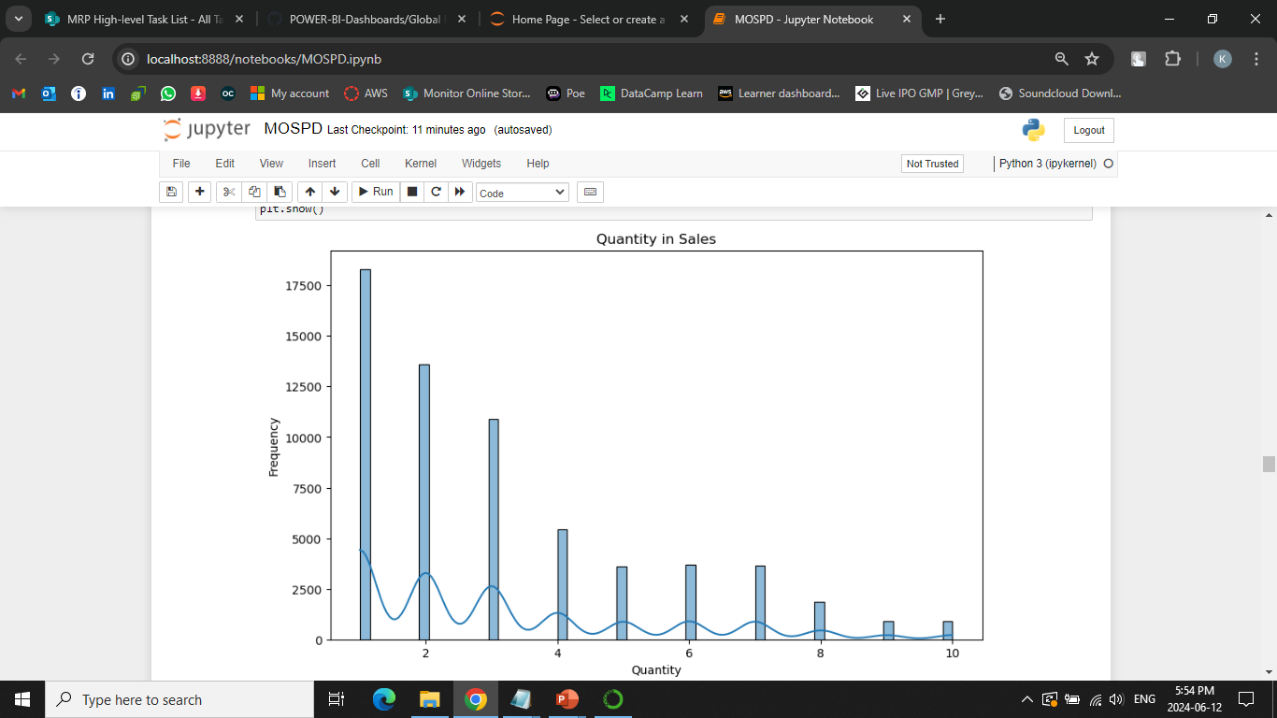

Slide 13
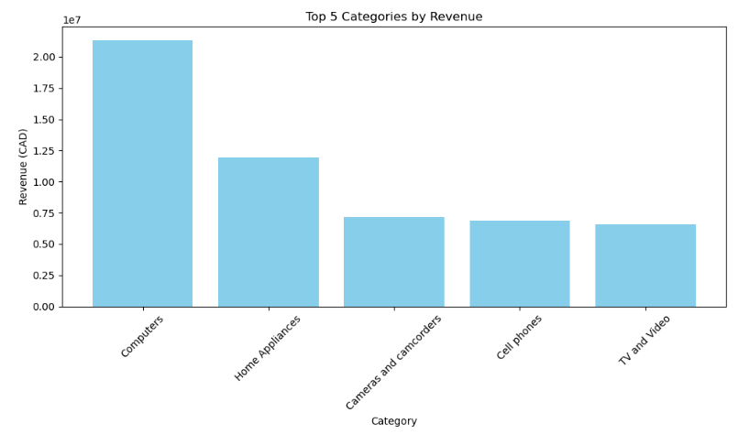
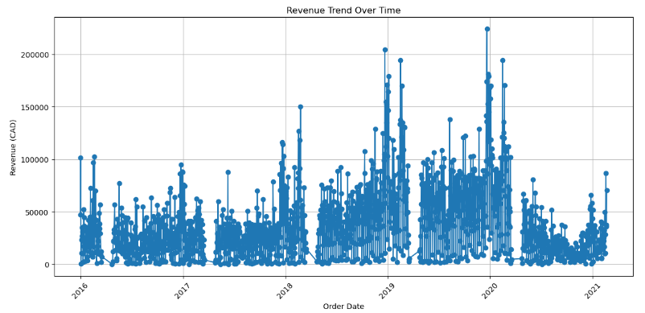

Slide 14
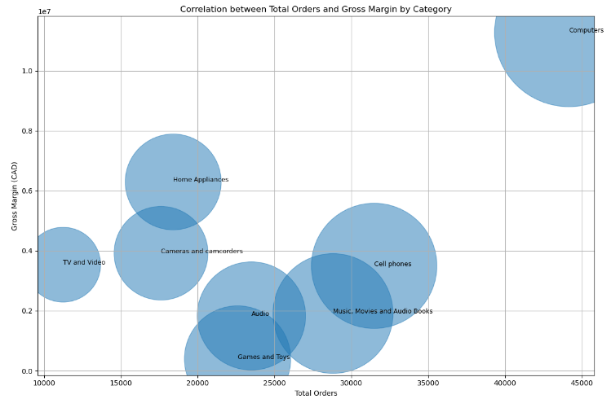
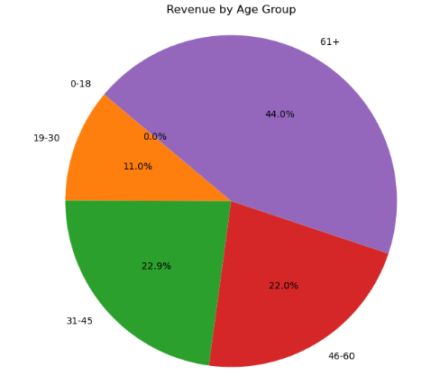

Slide 15
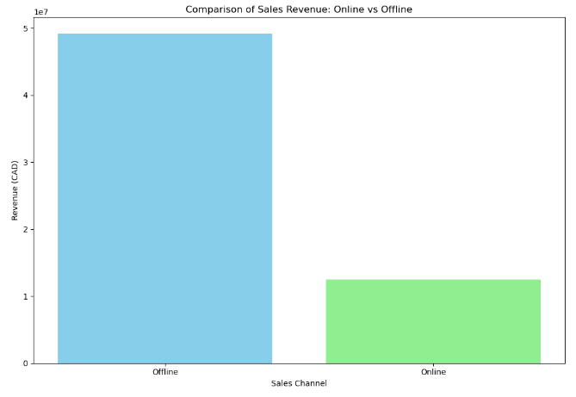
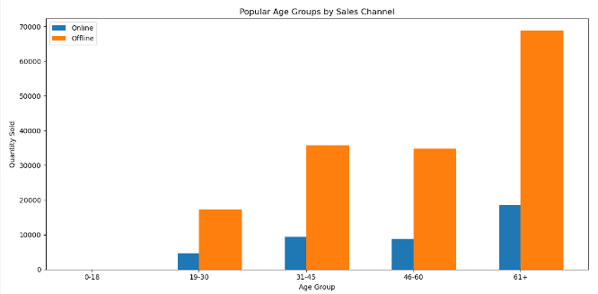

Slide 16
Predictive Analysis:
Completed predictive models on product-level sales trends.
Evaluated accuracy and performance of predictive models.
Cleaned and applied feature engineering to enhance dataset.

Slide 17
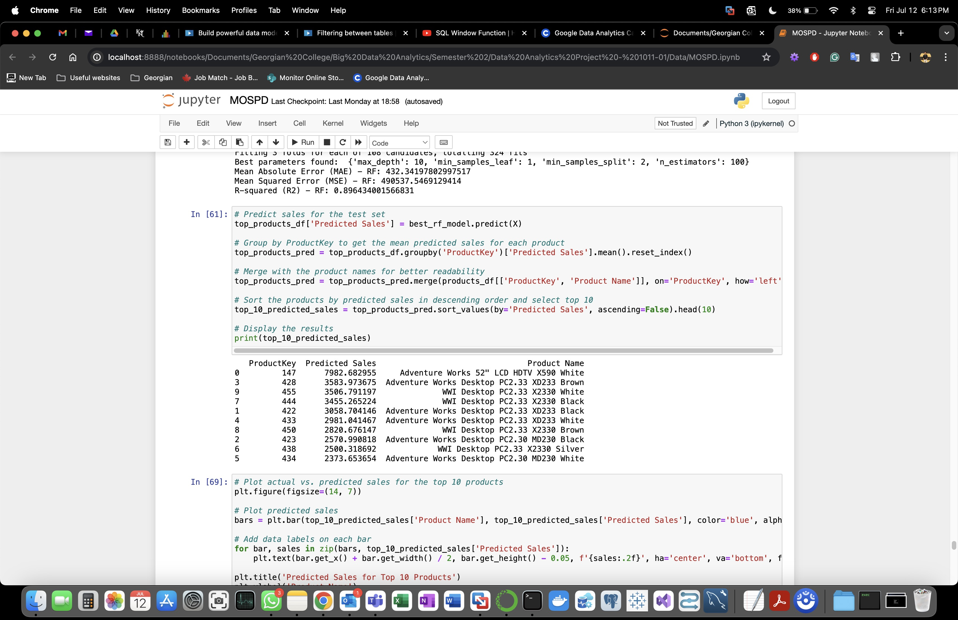

Slide 19
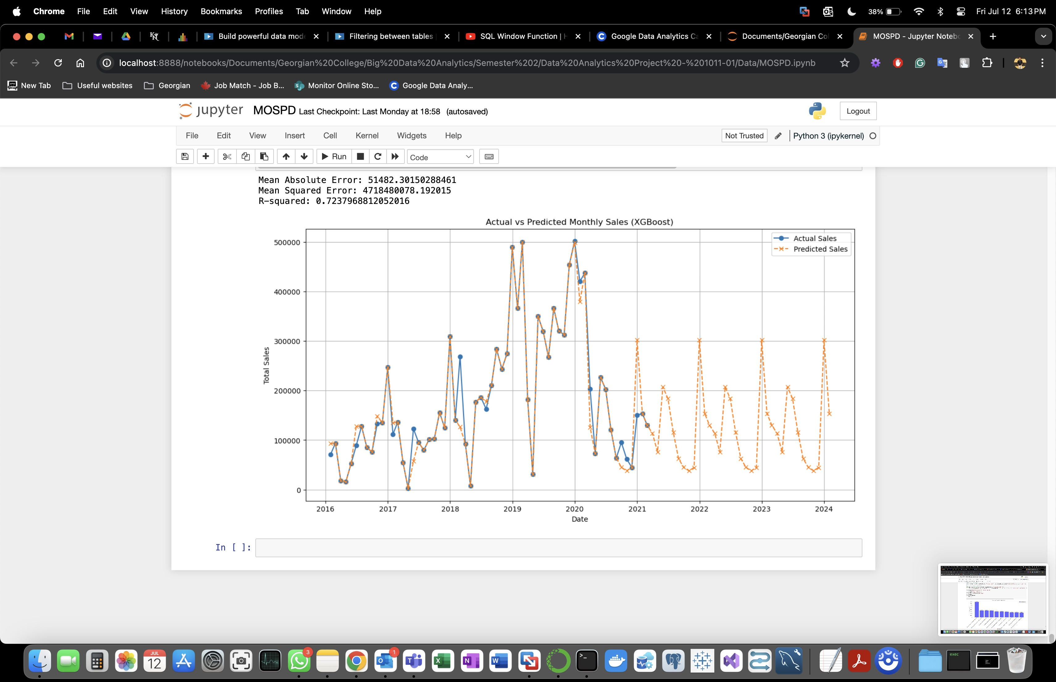

Slide 20
Final Dashboard Development:
Loaded dataset into Power BI, established STAR schema data model.
Designed dashboard pages: Overview, Customer Segment, Location, Product
KPI charts to compare revenue, order, and profit to previous month
Attached store logo, add filters to enhance interaction

Slide 21

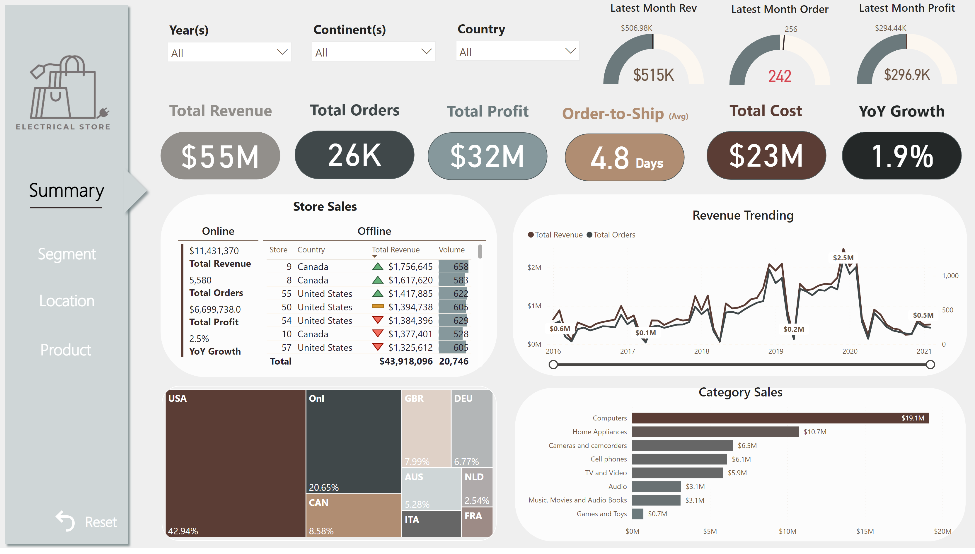
Microsoft Power BI

Slide 22
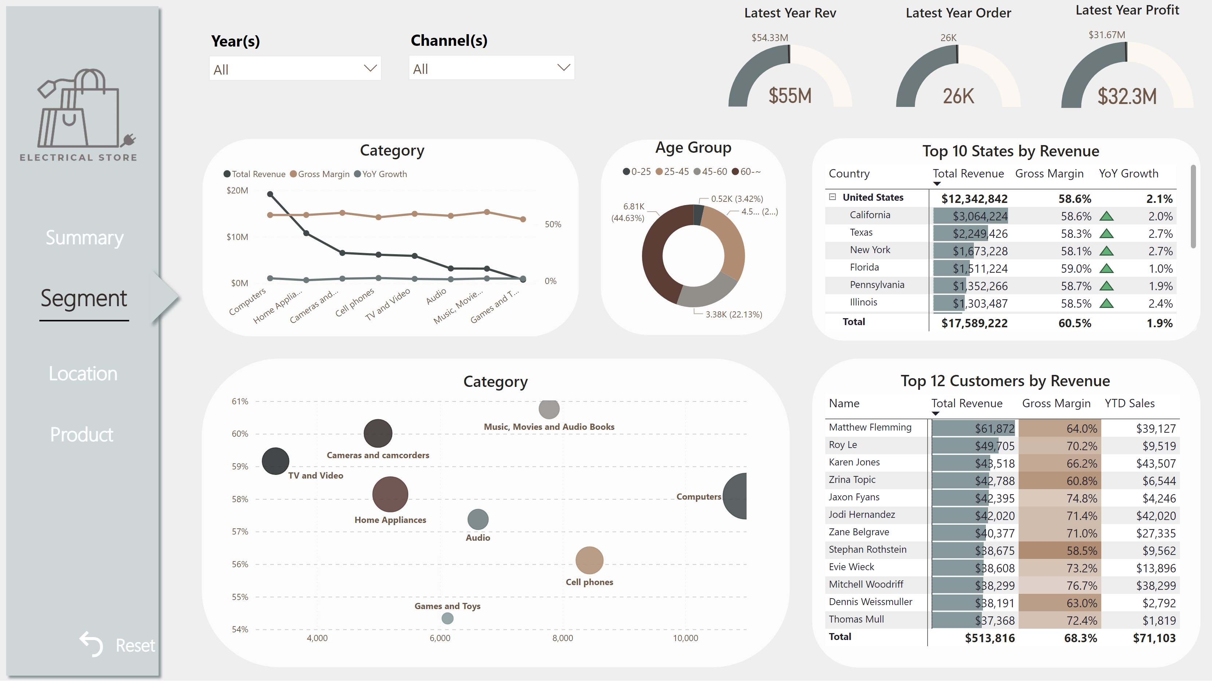
Microsoft Power BI

Slide 23
Challenges:
Internal team deliberations took place to allocate specific responsibilities to each team member, fostering swift and efficient completion of tasks amidst uncertainties.
The SharePoint site was completely redefined because the previous version didn't meet standards, necessitating updates to both content and layout.
Conducted Exploratory Data Analysis (EDA) by creating visualizations and selecting specific analyses for each column, while adopting a business-owner perspective to uncover insights.
Evaluated and improved model performance by selecting suitable Python libraries, cleaning data, and removing null entries and outliers, with the objective to predict revenue and determine top products.
Collaboratively connected and loaded data into Power BI, determining the best approach through discussions.
Identified and selected appropriate KPI metrics through group discussions, ensuring alignment with project goals.

Slide 24
Project Cost:
Budgeted Cost: $7900
Actual Cost: $6600

Slide 25
Project Results:
Sales declined in 2020 due to the impact of COVID-19.
The top 5 revenue-generating categories are Computers, Home Appliances, Cameras and Camcorders, Cell Phones, and TV and Video.
Over 40% of revenue is generated by customers aged 61+, followed by 22.9% from the 31-45 age group, 22% from the 46-60 age group, and 11% from the 19-30 age group.
The most popular items by age group are:
61+: WWI Desktop PC3.0 M0300 Black
46-60: WWI Desktop PC1.80 E1800 White
31-45: Adventure Works Desktop PC1.60 ED160 Black
19-30: Adventure Works Desktop PC2.30 MD230 White
0-18: Datum Advanced Digital Camera M300 Azure
Offline sales are preferred over online sales due to the nature of the products and customers' preference to test electronic items before purchasing.

Slide 26
Conclusion:
Sales experienced a decline in 2020 due to the adverse effects of COVID-19. Despite this, the top revenue-generating categories remained strong, with Computers, Home Appliances, Cameras and Camcorders, Cell Phones, and TV and Video leading the sales. These categories continued to attract significant consumer interest and spending.
Revenue distribution showed a clear preference among different age groups, with over 40% of total revenue coming from customers aged 61 and older. This was followed by 22.9% from the 31-45 age group, 22% from the 46-60 age group, and 11% from the 19-30 age group. Each age group had specific preferences for popular items, ranging from desktop PCs in various configurations to digital cameras.
Offline sales were notably preferred over online sales due to the nature of the products and the customers' preference to physically test electronic items before purchasing. This trend was evident across all age groups, emphasizing the importance of in-store experiences. The most popular items varied significantly by age group, reflecting diverse preferences and needs among different customer demographics.

Slide 27
Thank You!

